Slide 1
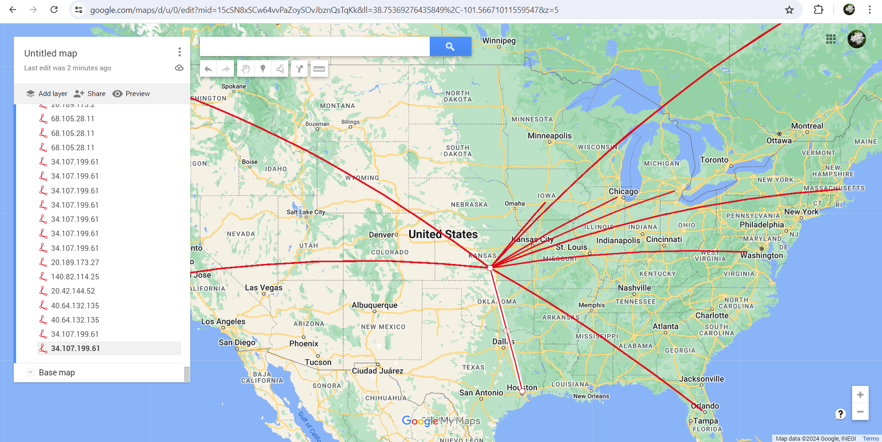
Python CyberSecurity Visual Network Tracker using Wireshark

Slide 2
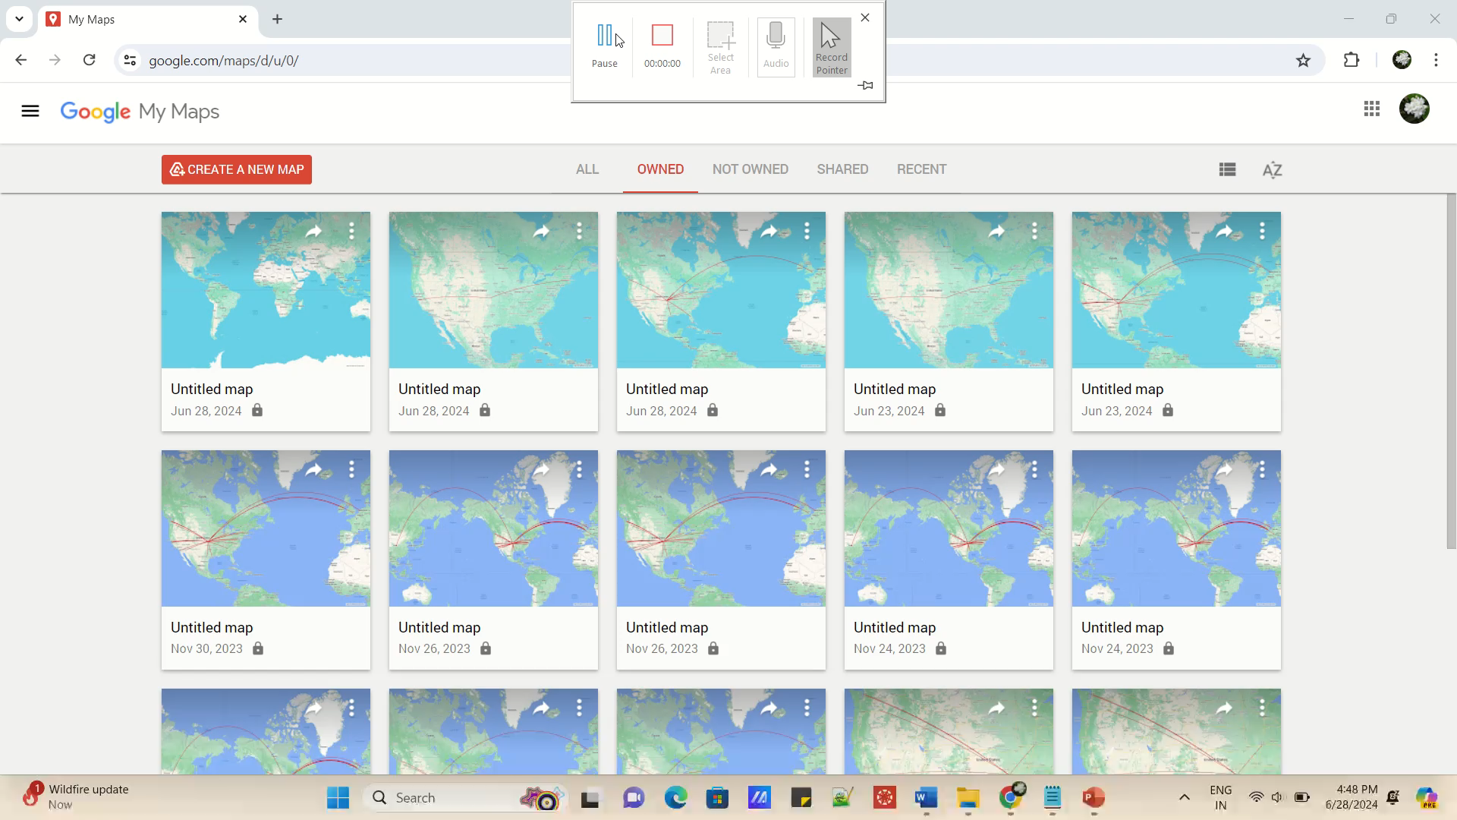

Slide 3
Git Hub link

